Slide 1


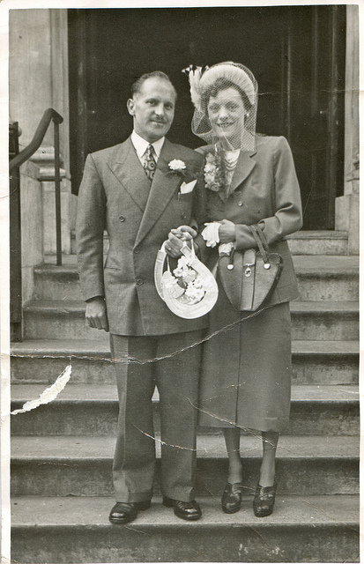
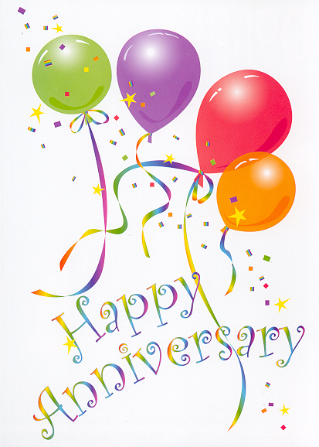
TOP TEN LIST
Top 10 Signs You’ve Been Married Over 45 Years

Slide 2
#10
Someone at work or church asks him to do something and he automatically responds “Yes Dear”!

Slide 3
#9
All the children in the house grow up and leave . . . . except the husband

Slide 4
#8
You discover that what’s hers is hers . . . and what’s his is hers, too!

Slide 5
#7
You knew you married “Miss Right” – you didn’t realize her first name is “Always”

Slide 6
#6
You’ve never considered divorce – but you have each thought about murder.

Slide 7
#5
She still lets him lick the beaters when making cake icing – but she leaves them plugged in!

Slide 8
#4
“Afternoon Delight” now means two glasses of Metamucil.

Slide 9
#3
You still go out to a restaurant twice a week for a little candlelight dinner, some soft music, and a slow walk home . . SHE goes on Sundays, HE goes on Wednesdays!

Slide 10
#2
If he makes a decision in the forest with no one to hear it, he’s still wrong!

Slide 11
And the #1 sign . . .
A thief steals her credit card, and he doesn’t report it because the thief is spending less than she was!

